Slide 1


A Flexible Approach to Improving System Reliability with Virtual Lockstep
Authors: Casey M. Jeffery, Renato J. O. Figueiredo

Slide 2

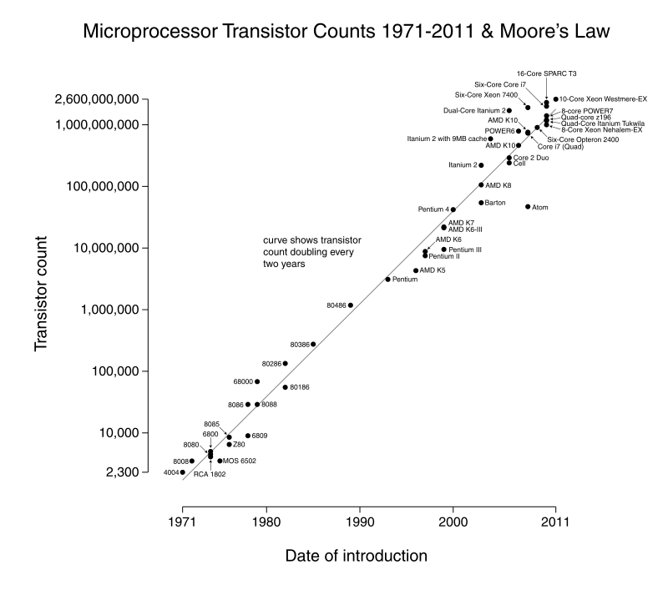
The rise of errors
Incrementing the transistor density
Incrementing the error rate*
Could affect: registers, bus, memory, cache, ...
Have you ever faced a system crash due to a machine error?
*The reliability of a single transistor doesn't improve much

Slide 3
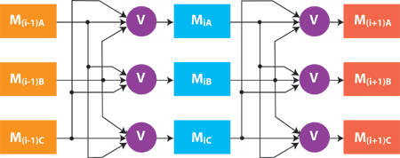
Hardware approach
Key idea: use redundancy in hardware to address errors
Examples:
1. ECC for memory and
caches.
TRM, Hamming, ...
CPU 1
instr 1
instr 2
instr 3
(error)
instr 4
2. Replicated execution
for (elite) processors
check
rollback
CPU 1
(replica)
instr 1
instr 2
instr 3
instr 4

Slide 4
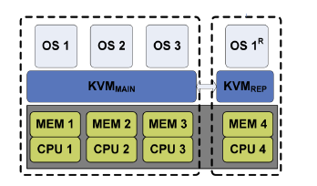
Virtual Lockstep
The protected guest OS runs on a hypervisor (KVM)
Virtual processors are fingerprinted at each VM exit
A replica of the OS executes on a different CPU
A first-glance comparison with the hardware approach?
Notes:
We need at least 2 cores. We are addressing just core replication, not memory, disks etc...

Slide 5
Virtual Lockstep & Non-determinism
To run error checking on two replicas,
they have to behave in a comparable manner
Which are all the sources of non-determinism in modern architectures?
Which one we need to address?
Notes:
We need at least 2 cores. We are addressing just core replication, not memory, disks etc...

Slide 6
Virtual Lockstep (2)
The protected OS and its replica start with the same state
Each non-deterministic value produced by the OS is put in a buffer and consumed by the replica
Interrupts are buffered by the hypervisor and delivered to both OSes at the next synchronization point (VM exit)
Shared buffer
CPU 1
instr 1
RDTSC
instr 3
instr 4
RTDSC Value
2
1
CPU 1
(replica)
instr 1
RDTSC
instr 3
instr 4
VM exit
Notes:
We need at least 2 cores. We are addressing just core replication, not memory, disks etc...

Slide 7
Virtual Lockstep (3)
The protected OS and its replica start with the same state
Each non-deterministic value produced by the OS is put in a buffer and consumed by the replica
Interrupts are buffered by the hypervisor and delivered to both OSes at the next synchronization point (VM exit)
CPU 1
(replica)
instr 1
instr 2
instr 3
instr 4
Shared buffer
Intr 1
Intr 2
CPU 1
instr 1
instr 2
instr 3
instr 4
3
VM exit
2
1
intr 1
intr 2
(physical layer)

Slide 8
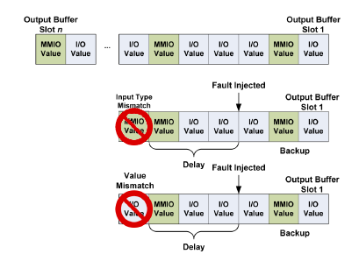
Virtual Lockstep (4)
At each VM exit, calculate a fast hash (fingerprint) for the state of both (the virtual CPUs of) the OS and its replica
If 2 fingerprints mismatch, error is detected -> rollback
Moreover, type of inputs and system outputs are checked
Input type check
+
Output value check
+
CPU fingerprinting
=
early error detection
Notes:
We need at least 2 cores. We are addressing just core replication, not memory, disks etc...

Slide 9



Discussion
Holly Decker
If virtual lock-stepping does away with specialized hw, under what scenarios or applications would users want lock-stepping capability?
Steven Dalton
Should applications requiring a high level of fault- tolerance be identified and executed using lockstep?
Fred Douglas
Instead of a cycle-by-cycle sync, [...] shouldn't it be possible to do the same thing in hardware at just a slightly higher level?

Slide 10
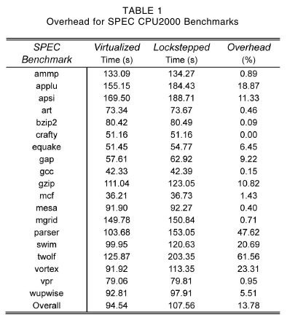
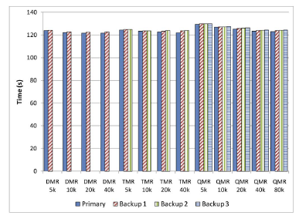
Evaluation
Does the additional logic produces overhead?
Of course it does: almost 14%
(like nested virtualization)
What if we add more replication?
{D, T, Q}MR = guest OS + {1, 2, 3} replicas
Notes:
We need at least 2 cores. We are addressing just core replication, not memory, disks etc...

Slide 11
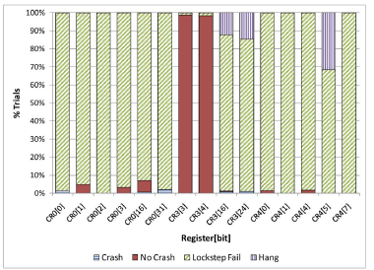
Evaluation
Which errors virtual lockstep can correct?
Crash →system fails and stop executing
Lockstep fail →error detected using I/O
comparison (no fingerprinting)
Hang →no progress made, but the system
keeps executing
CR0 = System wide flags: operation mode,
paging, caching, ...
CR3 = Page directory base address
CR4 = Page size, page global enable, PAE, ...
✓ In the majority of cases, traditional lockstep is enough
✗ Some CR bits cause crashes before any visible I/O
Notes:
We need at least 2 cores. We are addressing just core replication, not memory, disks etc...

Slide 12
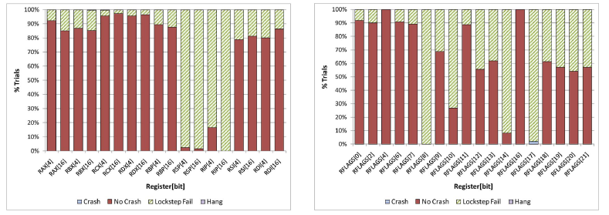
Evaluation
Which errors virtual lockstep can correct?
RAX- RDX = General purpose registers
RBP, RSP = Stack pointers
RIP = Instruction pointer
RSI, RDI = Source, dest. pointers
RFLAGS = Status, control, system flags
✓ Not so many of these registers produce a
visible difference in I/O operations
✓ For those who do, traditional lockstep is
a solution
Notes:
We need at least 2 cores. We are addressing just core replication, not memory, disks etc...

Slide 13
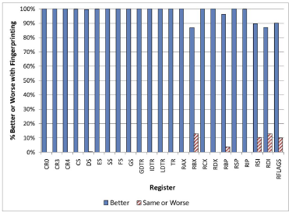

Evaluation
How fingerprinting performs with respect to v. lockstep?
Better
errors are detected earlier
Same or worse
error detected at the same VM exit or later
Aamer Charania
Any idea about how to reduce fingerprinting overhead?
Notes:
We need at least 2 cores. We are addressing just core replication, not memory, disks etc...

Slide 14
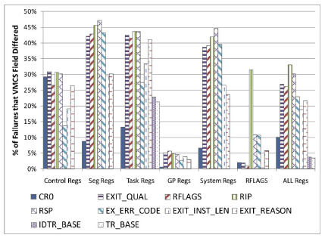
Evaluation
Error propagation analysis
How to read the graph:
...
...a divergence is detected in...
...in the X% of cases.
if an error is injected in CR0...
Fingerprinting optimization: perform hashing on the set of register
which are always affected.
Notes:
We need at least 2 cores. We are addressing just core replication, not memory, disks etc...

Slide 15
Conclusions
Can Virtual Lockstep achieve the same
goals as the hardware approach ?
Can we catch all the faults?
Is the overhead acceptable?
Can the overhead be improved?
Can we assign more cores to
a lockstepped guest OS?
YES
YES
Y/N
WIP
NO

